Slide 1

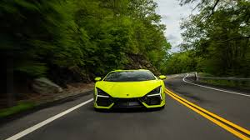
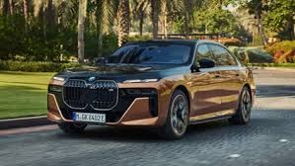
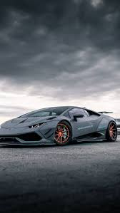
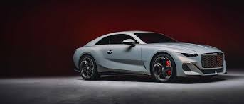
Vehicle Price Prediction System Using Deep Learning
Presented by – Aritra Mukherjee
ID: UMIP270247
Machine Learning Intern
At - Unified Mentor Pvt. Limited
Aritra Mukherjee

Slide 2
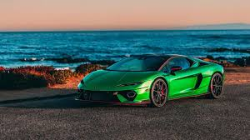
Introduction To Project –
Vehicle Price Prediction
Rapid increase in online vehicle marketplaces has made price estimation crucial.
Manual pricing can be inaccurate and biased.
Our solution uses machine learning to predict accurate vehicle prices based on features like make, model, fuel type, etc.
Aritra Mukherjee

Slide 3
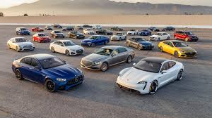
GOAL
Build a regression model using Deep Learning to accurately predict vehicle prices.
Analyze patterns from various vehicle specifications.
Assist buyers/sellers in determining fair market prices.
Aritra Mukherjee

Slide 4
Dataset Overview
File:
dataset.csv – Given By Unified Mentor.
Cleaned using forward fill and null removal.
Key Features:
Name,
model,
year,
mileage,
fuel_type,
transmission,
engine size,
price (target)
🧹 Preprocessing:
Label Encoding for categorical
Standard Scaling for numerical
Aritra Mukherjee

Slide 5

Tech Stack
Technologies & Tools Used
Component | Tools/Libraries | Purpose
Programming Language | Python | Core language for development
Data Manipulation | pandas, NumPy | Handling, cleaning, and transforming data
Visualization | matplotlib, seaborn | Plotting distributions and trends
Preprocessing | scikit-learn (LabelEncoder, StandardScaler) | Encoding categorical features and scaling numerical ones
Modeling | TensorFlow, Keras | Building and training deep learning models
Model Saving | joblib | Saving pre-trained models
Aritra Mukherjee

Slide 6
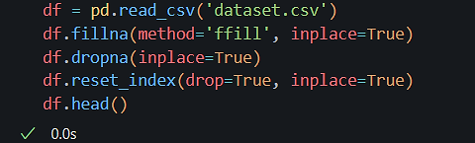
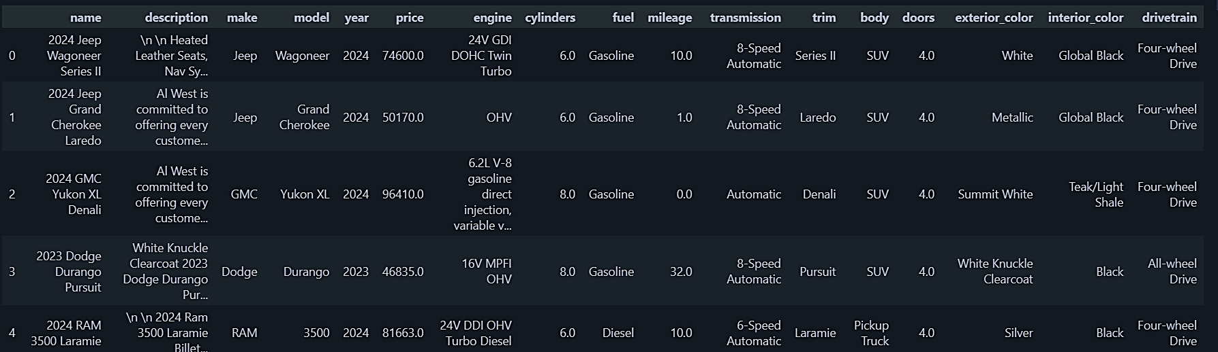
Data Preprocessing
Aritra Mukherjee

Slide 7
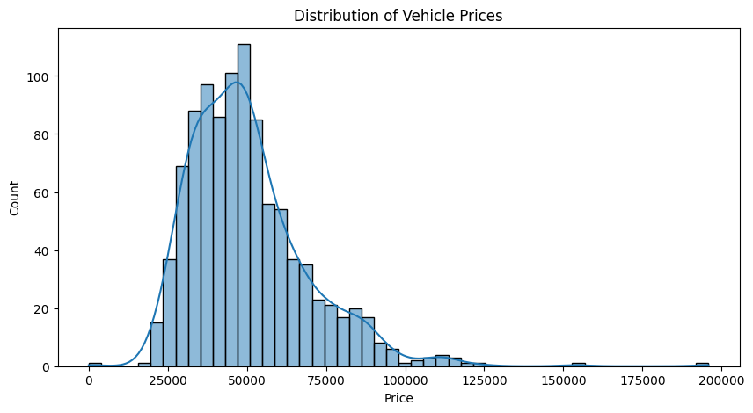
Visualize price distribution
Aritra Mukherjee

Slide 8
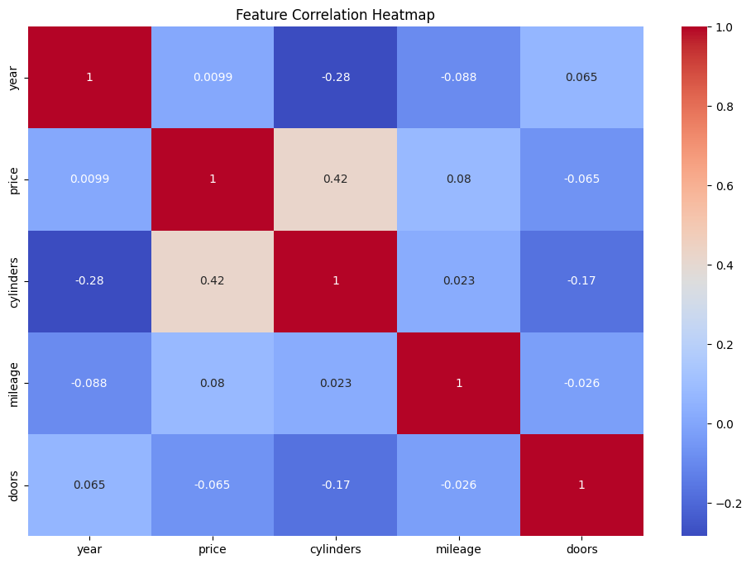
Correlation heatmap for numeric features

Slide 9
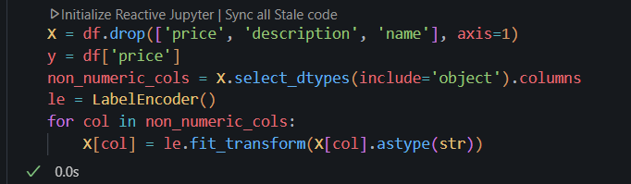
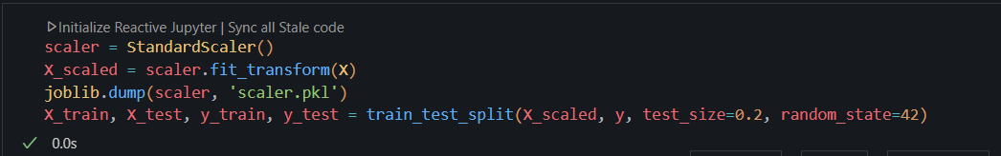
Encode categorical features
Model Training & Evaluation
Aritra Mukherjee

Slide 10
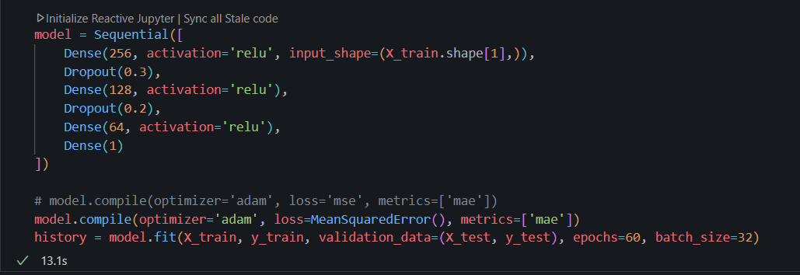
Model Architecture
Aritra Mukherjee

Slide 11
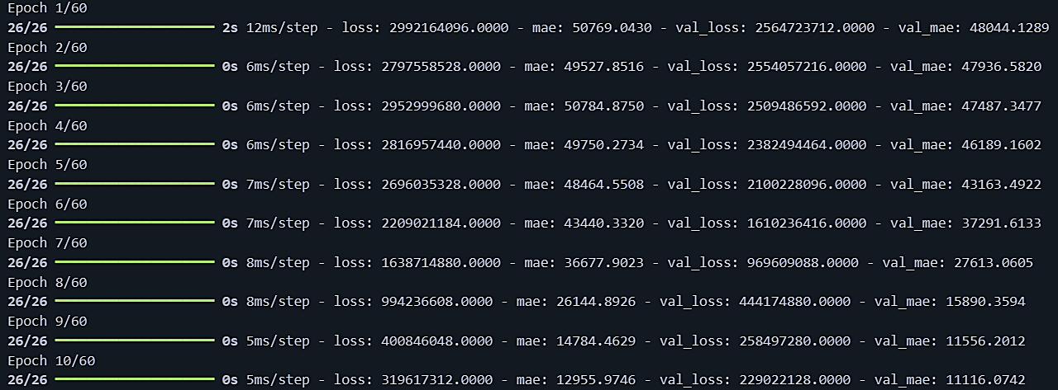
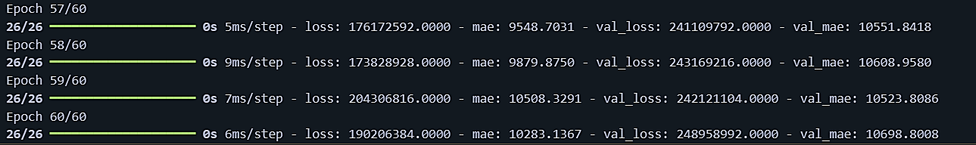
Train the Model
Aritra Mukherjee

Slide 12
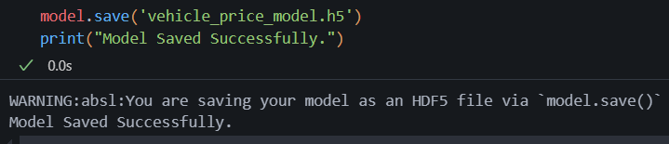
Save the Trained Model
Aritra Mukherjee

Slide 13
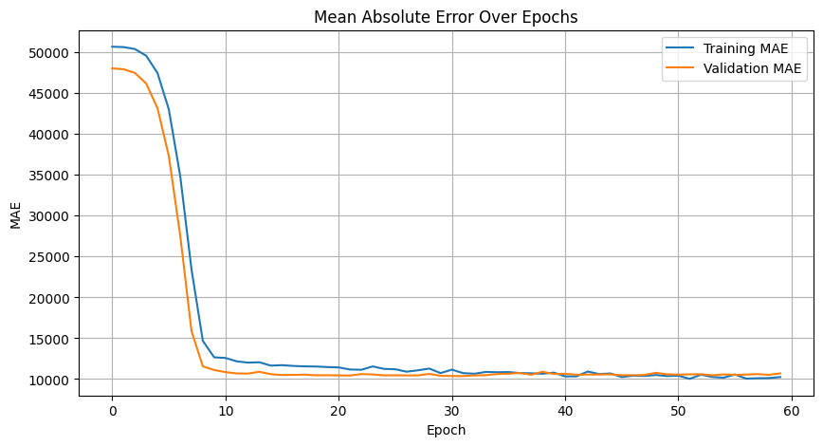
Mean Absolute Error Over Epochs
Aritra Mukherjee

Slide 14
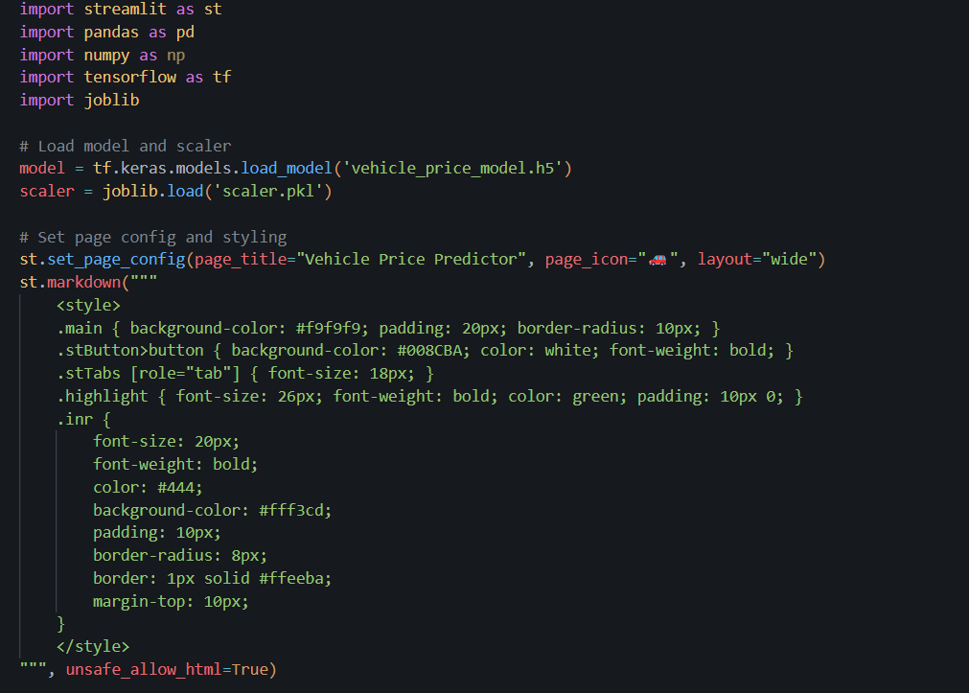
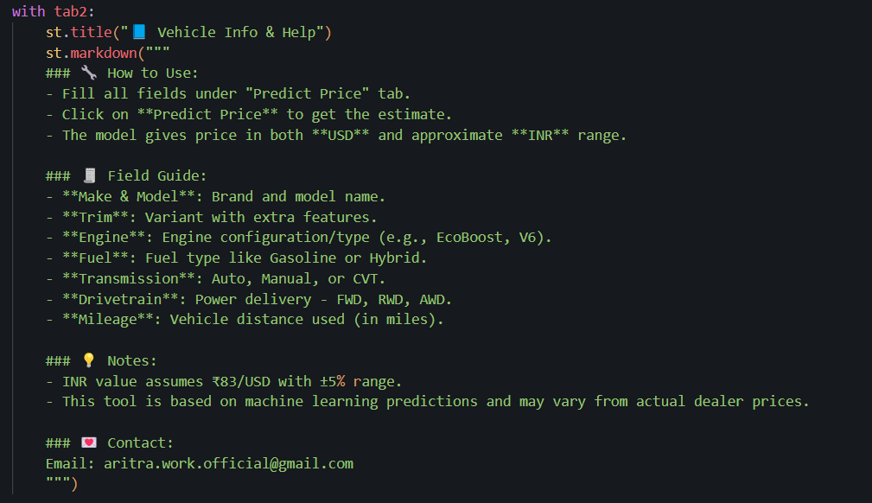
UI CODE

Slide 15
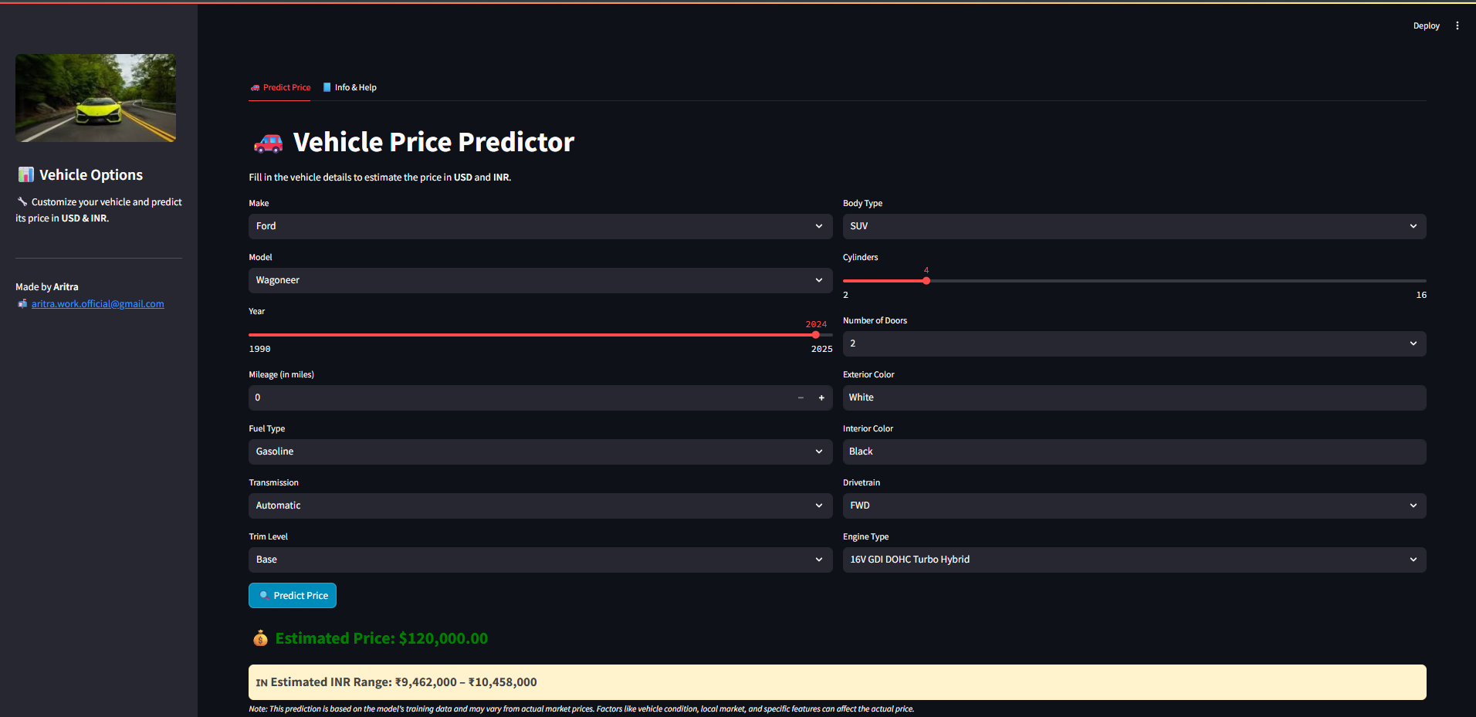
Prediction
Aritra Mukherjee

Slide 16

Prediction
Aritra Mukherjee

Slide 17
GitHub Repo-
Vehicle-Price-Prediction-APP
Aritra Mukherjee

Slide 18
Conclusion
A deep learning-based model can effectively predict vehicle prices using structured tabular data.
Practical use in e-commerce platforms and dealership valuation.
Aritra Mukherjee

